Slide 1
An Introduction to Biomedical Data Science
BIOSTAT 707 – Lecture 1
Fall 2022

Slide 2
Schedule for today
Course Introduction
2. Introduction to Data Science 3. Syllabus
4. Honor Code
5. Getting to know each other

Slide 3
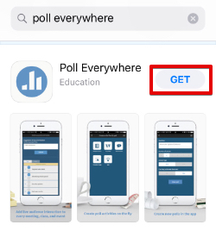
Taking the temperature of the room: PollEverywhere
37607
* Use your netID when you create your PollEverywhere Account

Slide 4
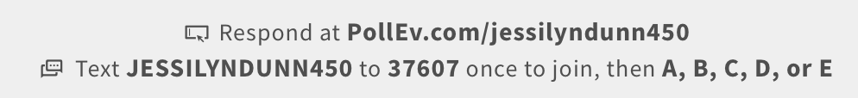
Two ways to respond to PollEverywhere surveys:
Be sure to respond to polls!
Your responses will be included in your course participation assessment

Slide 5
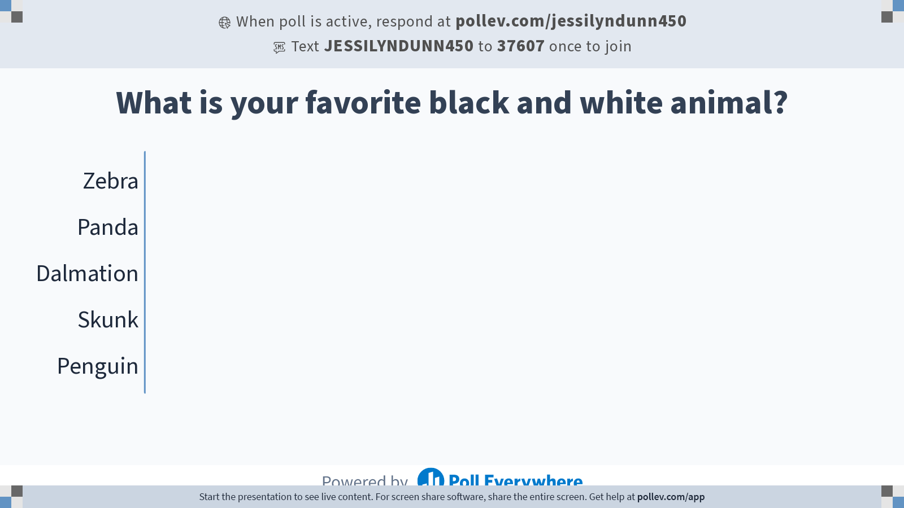
Notes:
Do not modify the notes in this section to avoid tampering with the Poll Everywhere activity. More info at polleverywhere.com/support What is your favorite black and white animal?
https://www.polleverywhere.com/multiple_choice_polls/hNZPX2hTQaxrWHj9mCGjR?state=opened&flow=Default&onscreen=persist

Slide 6
Mine is Tux the Penguin
Notes:
Tux is a penguin character and the official brand character of the Linux kernel. Originally created as an entry to a Linux logo competition, Tux is the most commonly used icon for Linux, although different Linux distributions depict Tux in various styles.

Slide 7
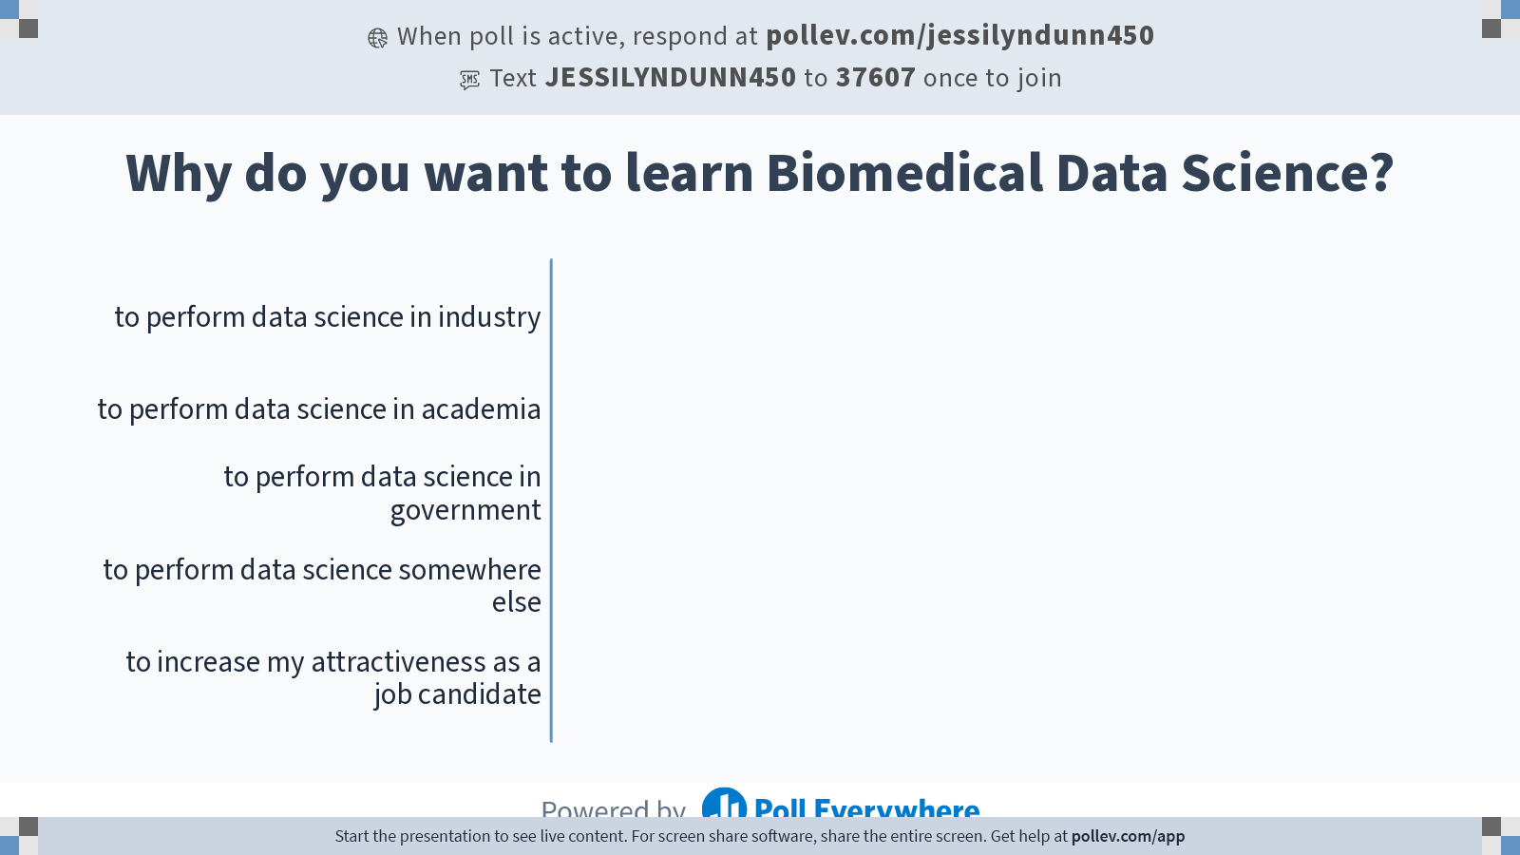
Notes:
Do not modify the notes in this section to avoid tampering with the Poll Everywhere activity. More info at polleverywhere.com/support Why do you want to learn Biomedical Data Science?
https://www.polleverywhere.com/multiple_choice_polls/MhJMCIP7Iz7J4TDjM6e2m?state=opened&flow=Default&onscreen=persist

Slide 8
Schedule for today
Course Introduction
2. Introduction to Data Science 3. Syllabus
4. Honor Code
5. Getting to know each other

Slide 9
Course Introduction
Theory and application of biomedical data science principles using multi-scale & multi-modal biomedical data:
multi-omics
wearable sensors
electronic health records

Slide 10
What do we mean by “multi-scale”?

Slide 11
What do we mean by “multi-modal”?
Multiple measurement modalities that generate the data we are using

Slide 12
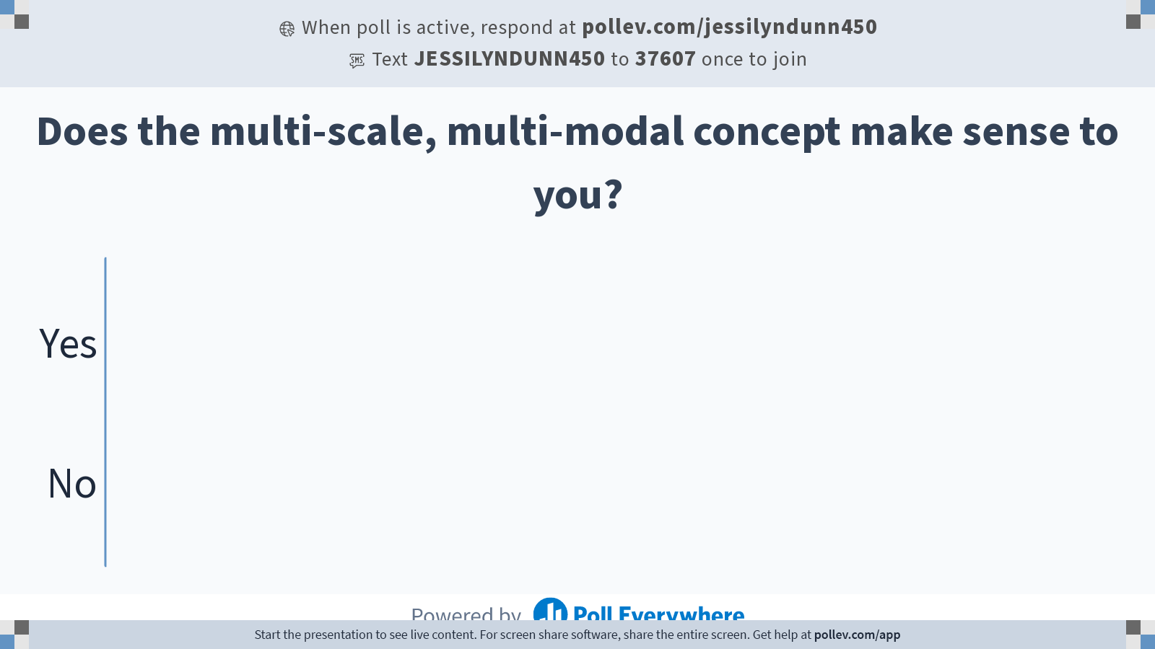
Notes:
Do not modify the notes in this section to avoid tampering with the Poll Everywhere activity. More info at polleverywhere.com/support Does the multi-scale, multi-modal concept make sense to you?
https://www.polleverywhere.com/multiple_choice_polls/8TQIfDi6muNwBYY2w9yv0?state=opened&flow=Default&onscreen=persist

Slide 13
Course Introduction Continued
Review of basic principles: data mining, exploratory data analysis, statistics
Introduction to supervised and unsupervised machine learning and model evaluation and selection methods

Slide 14
Course disclaimers
This course is being taught in flexible format that may be in person, become hybrid, or become remote, depending on the nature of the ongoing pandemic
Students in this course have varying backgrounds on the subjects presented here
I value your flexibility and continued feedback!

Slide 15
I care about your success!
We are learning together
Please keep me informed about what is working and what is not working for you
You can reach me after class, by email, or during my office hours.

Slide 16
Course Learning Objectives
Differentiate between multi-omics, wearable sensor, and electronic health records data types. Explain how each type of data is generated. Know databases where each type of data can be accessed.
Gain comfort with exploratory data analysis methods using R
Develop skills in reproducible computational and statistical research using RMarkdown
Develop intuition for appropriate analytic methodology for specific types of scientific questions and biomedical data
Produce and interpret statistical models and results correctly, effectively, and in context, without relying on jargon.

Slide 17
Course Details
Instructor: Dr. Jessilyn Dunn Email: jessilyn.dunn@duke.edu
Office Hours: 10-11am Thursdays – Hock Location TBD; Current location: Wilkinson #448
TA: Zachary Quinn
Email: zachary.quinn@duke.edu Office Hours: TBD by Poll – online & in-person to start
Textbook: An Introduction to Statistical Learning with Applications in R – James, Witten, Hastie, Tibshirani.
* An electronic version of this text is available for free through the Duke library. Supplemental text: Elements of Statistical Learning - Hastie, Tibshirani, Friedman.
Two optional supplemental textbooks: The Elements of Statistical Learning & APM
Software: The free computing language R will be used in in-class demos and homework assignments.

Slide 18
Schedule for today
Course Introduction
2. Introduction to Data Science 3. Syllabus
4. Honor Code
5. Getting to know each other

Slide 19
What is Data Science?
Extracting useful information and knowledge from large volumes of data in order to provide insights or improve decision-making

Slide 20
In other words…
Taking (usually large) data sets and annotating, cleaning, organizing, storing, and analyzing them for the purposes of extracting knowledge.
It merges the disciplines of statistics, computer science, and computational engineering.

Slide 21
How big is a “large” dataset?
Big data might be petabytes (1000 terabytes) or exabytes (1000 petabytes) of data…or even more!
Example: Health insurance records can contain billions to trillions of multi-modal records of >millions of people
Fun fact: The average movie size in 2012 was ~1GB. One exabyte is one BILLION movies! In 2010, Netflix had 6,755 movies. Biological and medical data are MUCH bigger than Netflix ”big data”!!
http://highscalability.com/blog/2012/9/11/how-big-is-a-petabyte-exabyte-zettabyte-or-a-yottabyte.html

Slide 22
What skills should a Data Scientist have?
There is no way to teach all of these skills in one course!!!
The field of data science constantly evolves and being a data scientist involves life-long learning
https://subscription.packtpub.com/book/big_data_and_business_intelligence/9781785283451/1/01lvl1sec1/the-sexiest-role-of-the-21st-century-data-scientist

Slide 23
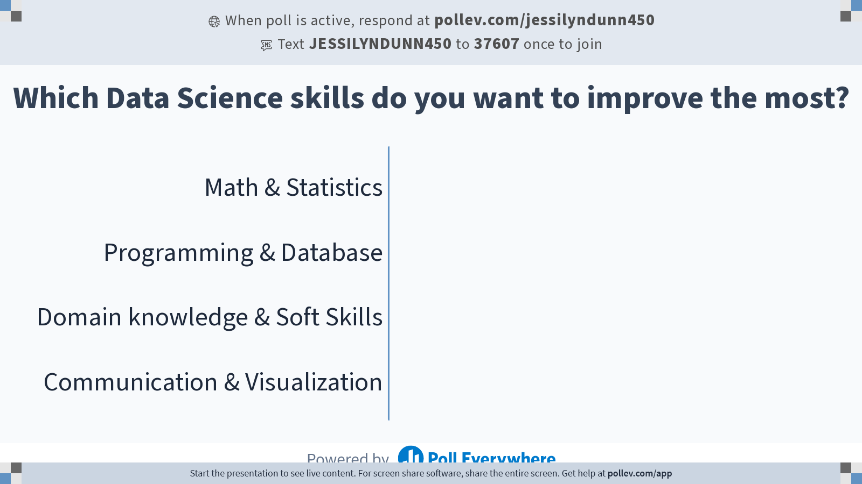
Notes:
Do not modify the notes in this section to avoid tampering with the Poll Everywhere activity. More info at polleverywhere.com/support Which Data Science skills do you want to improve the most?
https://www.polleverywhere.com/multiple_choice_polls/ofwoxKTy8l6Npu9GCNjQF?state=opened&flow=Default&onscreen=persist

Slide 24
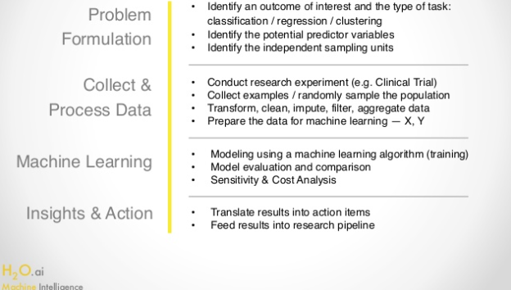
What does the Data Science process entail?

Slide 25
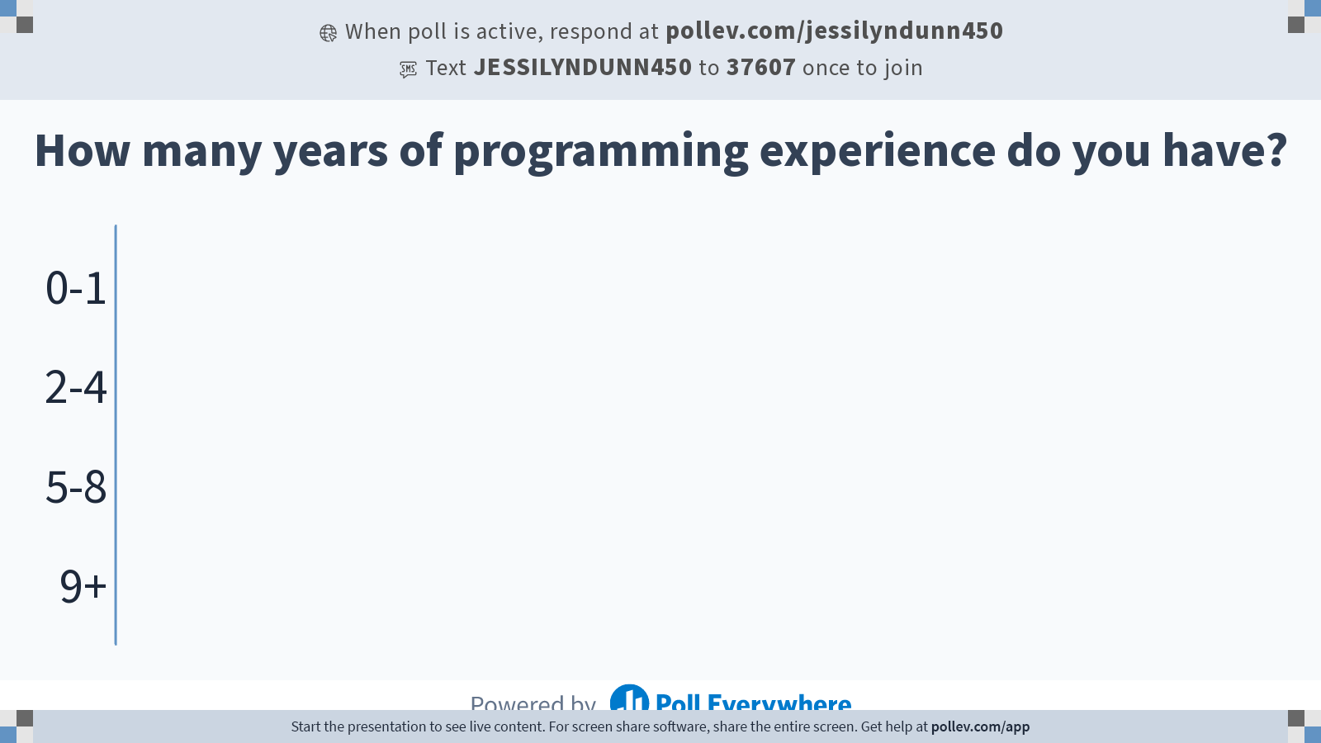
Notes:
Do not modify the notes in this section to avoid tampering with the Poll Everywhere activity. More info at polleverywhere.com/support How many years of programming experience do you have?
https://www.polleverywhere.com/multiple_choice_polls/FfejRYQgu6Sm8YxNUqxnF?state=opened&flow=Default&onscreen=persist

Slide 26
Schedule for today
Course Introduction
2. Introduction to Data Science 3. Syllabus
4. Honor Code
5. Getting to know each other

Slide 27
The final grade for the class will be based on the following:
30% Homework Assignments (5 Homeworks)
10% In Class Quizzes (4 Quizzes)
15% Midterm exam
5% participation
40% Project (2%- project group, 5%- proposal, 18% - final report, 15% - final presentation)
Academic Integrity: I expect for all students to adhere to the Duke Community Standard (https://studentaffairs.duke.edu/conduct/about-us/duke-community-standard). While I encourage group work and group studying, you must turn in your own work and copying homework solutions or other student’s work without working through the problems yourself will result in a grade of 0 for the assignment/exam. No exceptions.

Slide 28
Schedule for today
Course Introduction
2. Introduction to Data Science 3. Syllabus
4. Honor Code
5. Getting to know each other

Slide 29
Duke Community Standard
Duke University is a community dedicated to scholarship, leadership, and service and to the principles of honesty, fairness, respect, and accountability. Citizens of this community commit to reflect upon and uphold these principles in all academic and nonacademic endeavors, and to protect and promote a culture of integrity.
To uphold the Duke Community Standard:
I will not lie, cheat, or steal in my academic endeavors;
I will conduct myself honorably in all my endeavors; and
I will act if the Standard is compromised.

Slide 30

Graduate Communications Center (GCC)
One-on-One Coaching
Writing assignments
Research Papers
Cover Letters
PhD Publication/Dissertation/Prelims
Master’s Theses/Projects
Presentations
Small Talk Practice
Pronunciation Coaching
Intercultural situation navigation
Communication Workshop Series. Past Offerings
Managing Presentation Anxiety
Making Small Talk
Writing an SOP for PhD Applications
10 Tips to Instantly Improve Writing
Conversation Club – SnackChat!
gcc-pratt@duke.edu
https://pratt.duke.edu/grad/students/comms-and-intercultural-programs

Slide 31
Schedule for today
Course Introduction
2. Introduction to Data Science 3. Syllabus
4. Honor Code
5. Getting to know each other

Slide 32
Its nice getting to know you!
Name
Nickname
Gender pronouns if you desire to share
Major / Program & Year
Hometown
Favorite food
What is something new that you learned about Durham, Duke, yourself, or something else interesting in the past week?

